Slide 1
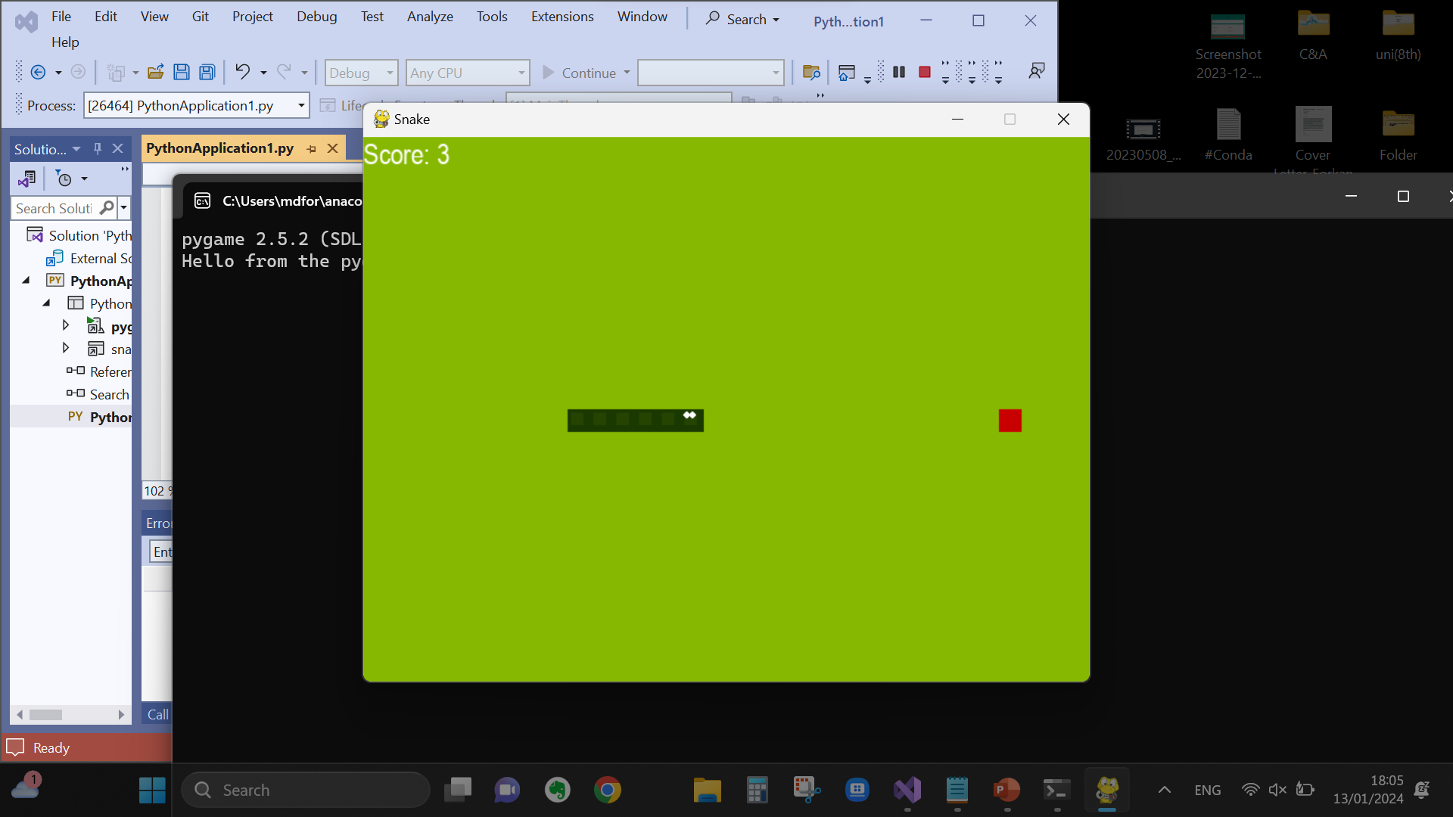
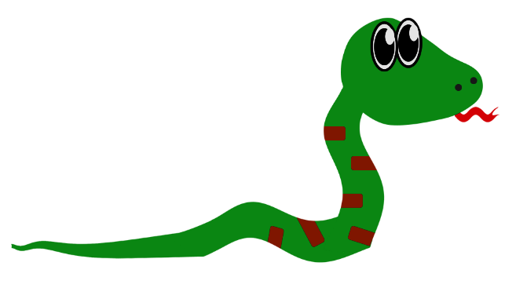
Snake Game Using Deep Reinforcement
Learning
Abdullah Al Forkan
Matriculation Number: 2190314

Slide 2
Motivation
I am going to present deep learning project of automatic snake game playing based on my research paper. I will give you a comprehensive understanding of deep learning applications in game development. The main purpose is to explore and analyse the practical insights of game construction, modelling human like behaviour, results and provide recommendations. With this motivation I will discuss the following methodologies:
DEEP REINFORCEMENT LEARNING
Q-Learning and DQ-Learning
Deep Q-Learning process
IMPLEMENTING THE SNAKE GAME
5. IMPLEMENTING THE AGENT
6. IMPLIMENTING THE MODEL
7. TRAINING AND TESTING

Slide 3
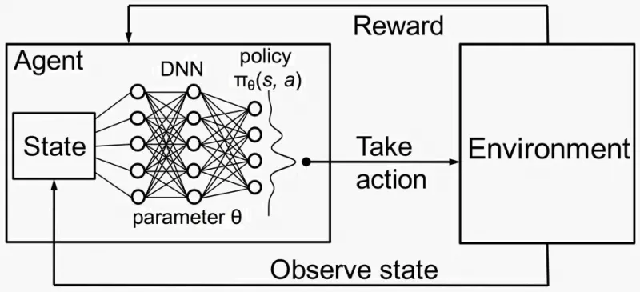
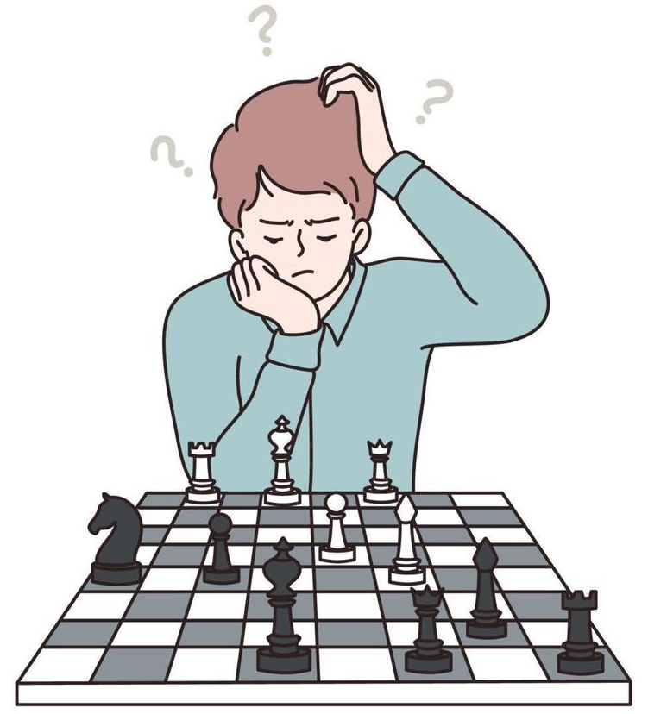
Deep Reinforcement Learning
Combines artificial neural networks with a framework of reinforcement learning that helps software agents learn how to reach their goals. That is, it unites function approximation and target optimization, mapping states and actions to the rewards they lead to.
Brain Stimulation: Reward/ Penalty
DRL Process

Slide 4
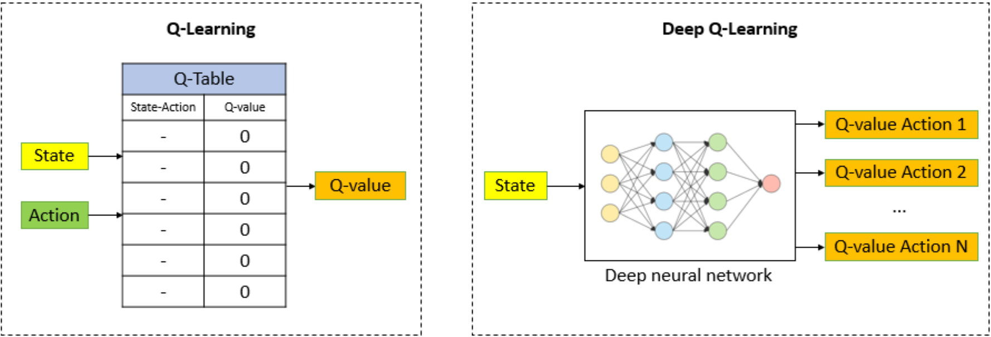
Q-Learning and DQ-Learning
Q-Learning is a value-based algorithm that is used to find the optimal policy for an agent in a given environment. It determines the best series of actions through the Bellman Equation.
Deep Q-Learning is introduced when Q-Learning fails to calculate many states and actions.

Slide 5
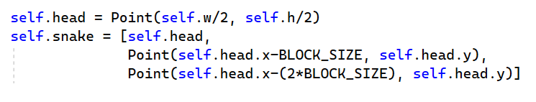
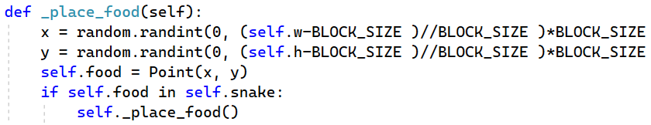
IMPLEM. THE SNAKE GAME
1. Basic Components Construction:
- Display
- Player/Snake
(640×480)
- Food

Slide 6
IMPLEM. THE SNAKE GAME
2. Play Steps
- Direction
• Straight – [1, 0, 0]
• Right turn – [0, 1, 0]
• Left turn – [0, 0, 1]
- Movement
• if direction == Direction.RIGHT: x += BLOCK SIZE
• elif direction == Direction.DOWN: y += BLOCK SIZE
- Reward and Score: Reward = +10 and penalty = -10
- Game Over: Collisions

Slide 7
IMPLEM. THE AGENT
1. Initials
- Max memory, Batch size, Learning rates, Epsilon, Discount rate
2. Direction setup
• Point right = Point (head.x + 20, head.y)
• Point Left = Point (head.x - 20, head.y)
Similarly, for Up (y + 20) and Down (y – 20)
3. Get States: 11 States
• Move direction states = [ left, right, up, down ]
• Danger zones = [ danger straight, danger right, danger left ]
• Food direction = [ left, right, up down ]

Slide 8
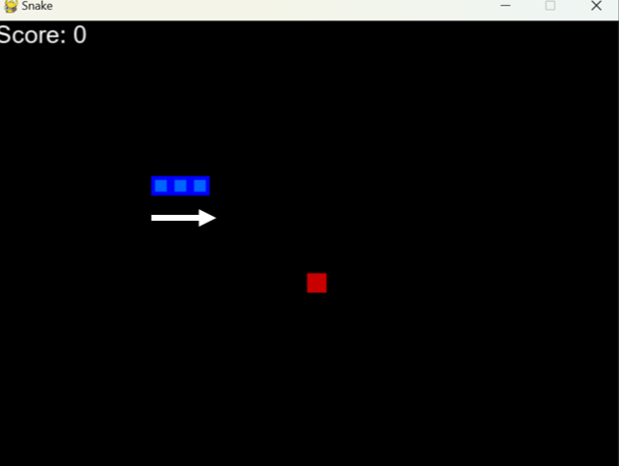
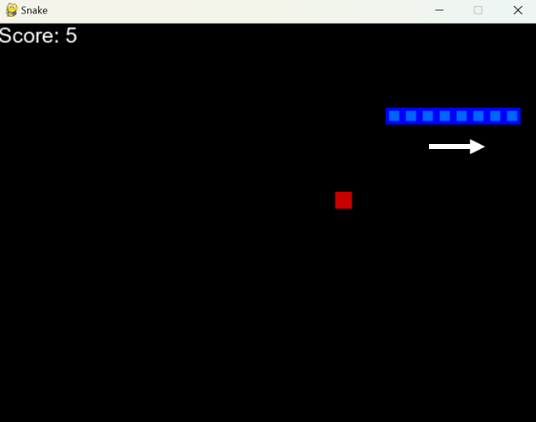
IMPLEM. THE AGENT
4. Scenarios
Danger zones | dan_straight, dan_right, dan_left | [0, 0, 0]
Direction states | left, right, up, down | [ 0, 0, 0, 0]
Food direction | left, right, up, down | [ 0, 0, 0, 0]
[0, 0, 0]
[ 0, 1, 0, 0]
[ 0, 1, 0, 0]
[1, 0, 0]
[ 0, 1, 0, 1]
[ 0, 1, 0, 1]

Slide 9
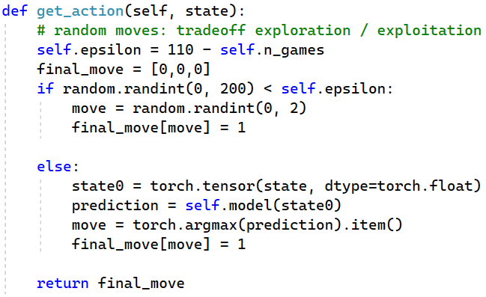
IMPLEM. THE AGENT
Saving functions: Remember, Train short & long memory
Get action: Random exploration & Exploitation:

Slide 10
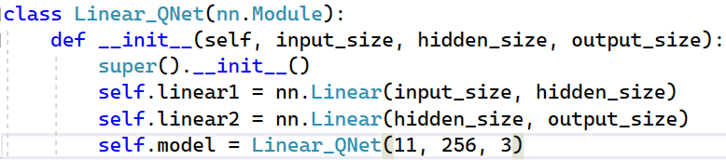
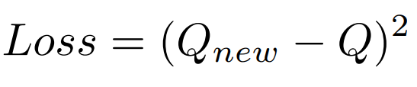
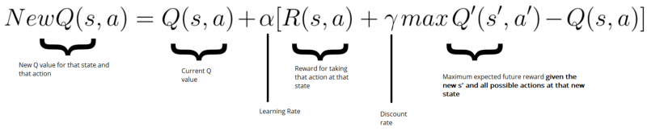
IMPLIMENTING THE MODEL
Linear Qnet:
2. QTrainer:
3. Q Value and Bellman Equation:

Slide 11
Deep Q-Learning process
Initialize Q-values
Choose action a for state s (Best Q-value)
Perform action a, new state s’
Measure reward R
Update Q with Bellman Equation
Update weights of the Neural Network
1
2
3
4
5
6

Slide 12
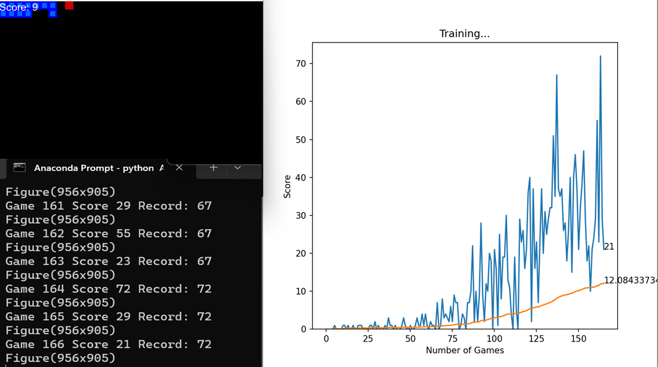
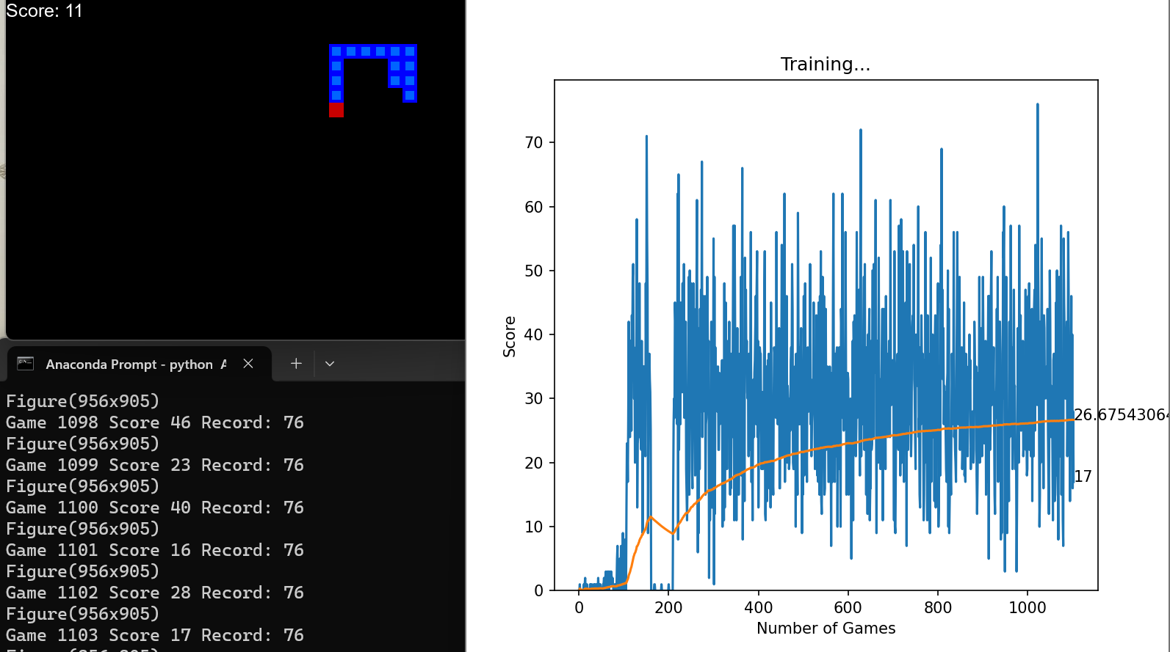
TRAINING AND TESTING
Test 1
Test 2

Slide 13
REFERENCES
https://medium.com/@vishnuvijayanpv/deep-reinforcement-learning-value-functions-dqn-actor-critic-method-backpropagation-through-83a277d8c38d
2. Baeldung on Computer Science, “Q-learning vs. deep q-learning vs.
deep q-network — baeldung on computer science,” 2023. [Online]. Available:
https://www.baeldung.com/cs/q-learning-vs-deep-q-learningvs-deep-q-network
3. freeCodeCamp.org, “Diving deeper into reinforcement learning with q-learning,”
freeCodeCamp.org, 10/04/2018. [Online]. Available:
https://www.freecodecamp.org/news/diving-deeperinto-reinforcement-learning-with-q-
learning-c18d0db58efe/
4. Patrick Loeber, “Python + pytorch + pygame reinforcement
learning – train an ai to play snake,” 2022. [Online]. Available:
https://www.youtube.com/watch?v=L8ypSXwyBds

